Slide 1


A Project
Presentation on
Resort management System
Presented by:
RITESH YAWALE (219146)
AKSHAY BHUSARI (219016)
Mr.Prashant Karhale Mr.Swapnil Golegaonkar & Manjiri Deshpande
Centre Coordinator Project Guide
Institute for Advanced Computing & Software Development (IACSD)

Slide 2
Today’s discussion aims …
—Introduction
—Motivation
—Objectives
__Proposed System
—System Architecture
—Description of system
—Applications
—Advantages and Disadvantages
—System Design and Database Tables
— Screenshots
—Future Enhancement
—Conclusions
—References

Slide 3
Introduction
Resort Management System is a web-based Resort management software. The software features include booking management, booking calendar, check ins & check outs management, payment and accounting document reports.
Interactive GUI and the ability to manage various Resort bookings and rooms make this system very flexible and convenient. This application gives him the power and flexibility to manage the entire system from a single online system. Customer can view and book room online. Resort Management project provides room booking, staff management.

Slide 4
Motivation
This online Resort management solution is fully functional and flexible.
It is very easy to use.
This online Resort management system helps in back Resort administration by streamlining and standardizing the procedures.
It saves a lot of time, and manage budgets.
Eco-friendly: The monitoring of the Resort management and the overall business becomes easy.
The application acts as an office that is open 24/7.
It increases the efficiency of the management at offering quality services to the customers. It provides custom features development and support with the application.

Slide 5
Objectives
The main perspective of this project is to provide a online platform for Booking of Resort’s room with secure payment option and easy done.
This is basically similar to going Resort and booking that we have. But with the use of computers for creating online platform, it will be easy for people to book Resort at any time.

Slide 6
Proposed System
The Resort management system provides the quality service to the end user. This project aims at creating on Resort Management System which can be used by Admin and Customers. The admin to advise/publish the availability of rooms in different Resorts and customers are checking the availability of room in required Resort. Customers should be able to know the availability of the rooms on a particular date to reserve in Resort. They should be able to reserve the available rooms according to their need in advance. To make their stay comfortable.

Slide 7
Description of System
This architecture diagram gives us the flow of the algorithm and overall functionality of the system.
The user of the system selects the Resort and the further process gets start.
This module provides the functionality for customers to book their room and supply necessary details. Users of the system, namely customers, must be provided the following functionality:
Create an account.
Log in to the system.
Navigate to the Resort & rooms gallery.
Book the suitable room.

Slide 8
Applications
This system will be implemented as a web application. We have created an Resort Management System web application where a gallery of Resorts & Rooms will be displayed.
As any other Resort reservation web application, this system will give many options to the user to book or just view a Resort & Room.

Slide 9
Advantages / Disadvantages
Advantage :
It provides the good publishing services to end users. Admin can publish or update the resort details and visible at users/customer side. So, it providing the good publishing process.
The central objective of Resort management is to provide online facility for booking rooms.
This project provides high security to Admin and user information.
This software can manage and keep records of Resort.
Disadvantage :
In the existing system, only provides the information about particular Resort and only some of the Resorts has possibility to reserve the rooms.
The previous system was failure to publish the room’s availability of multiple Resorts.
And, It is failure to provide defence to admin and user information

Slide 10
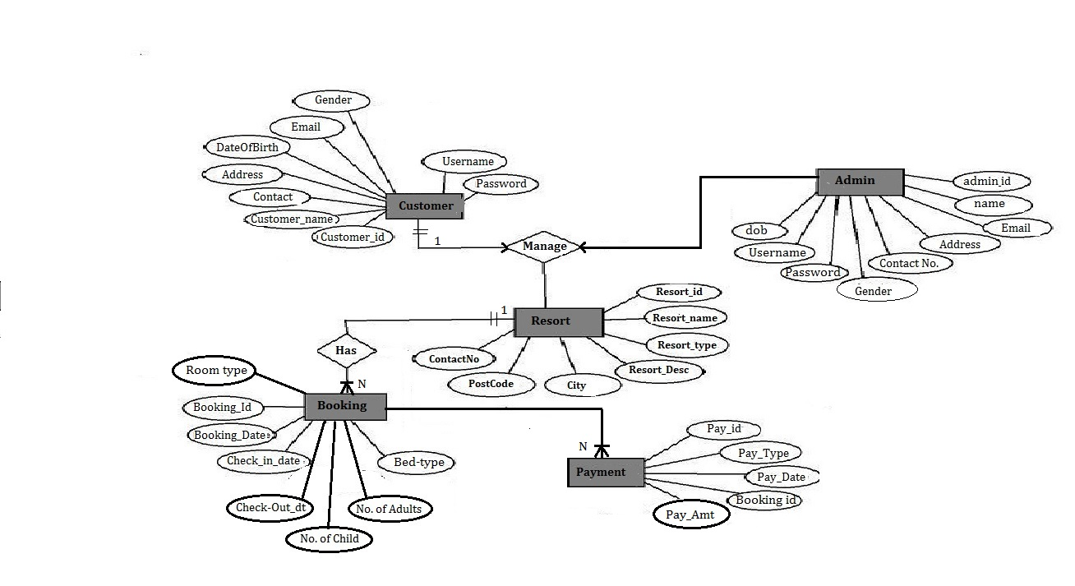
ER - Diagram

Slide 11
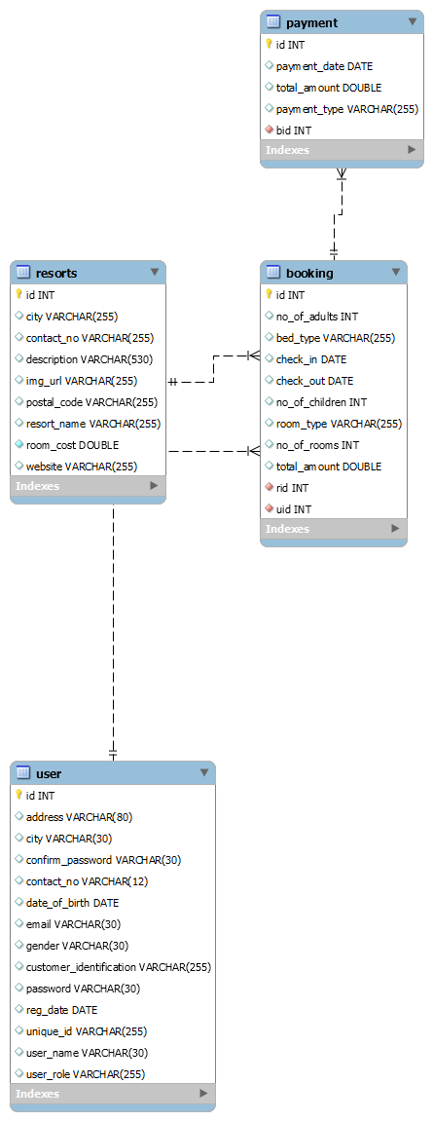
ER – Diagram (Sql auto generated)
Email
Password
UserRole
Bill and
Logout page

Slide 12
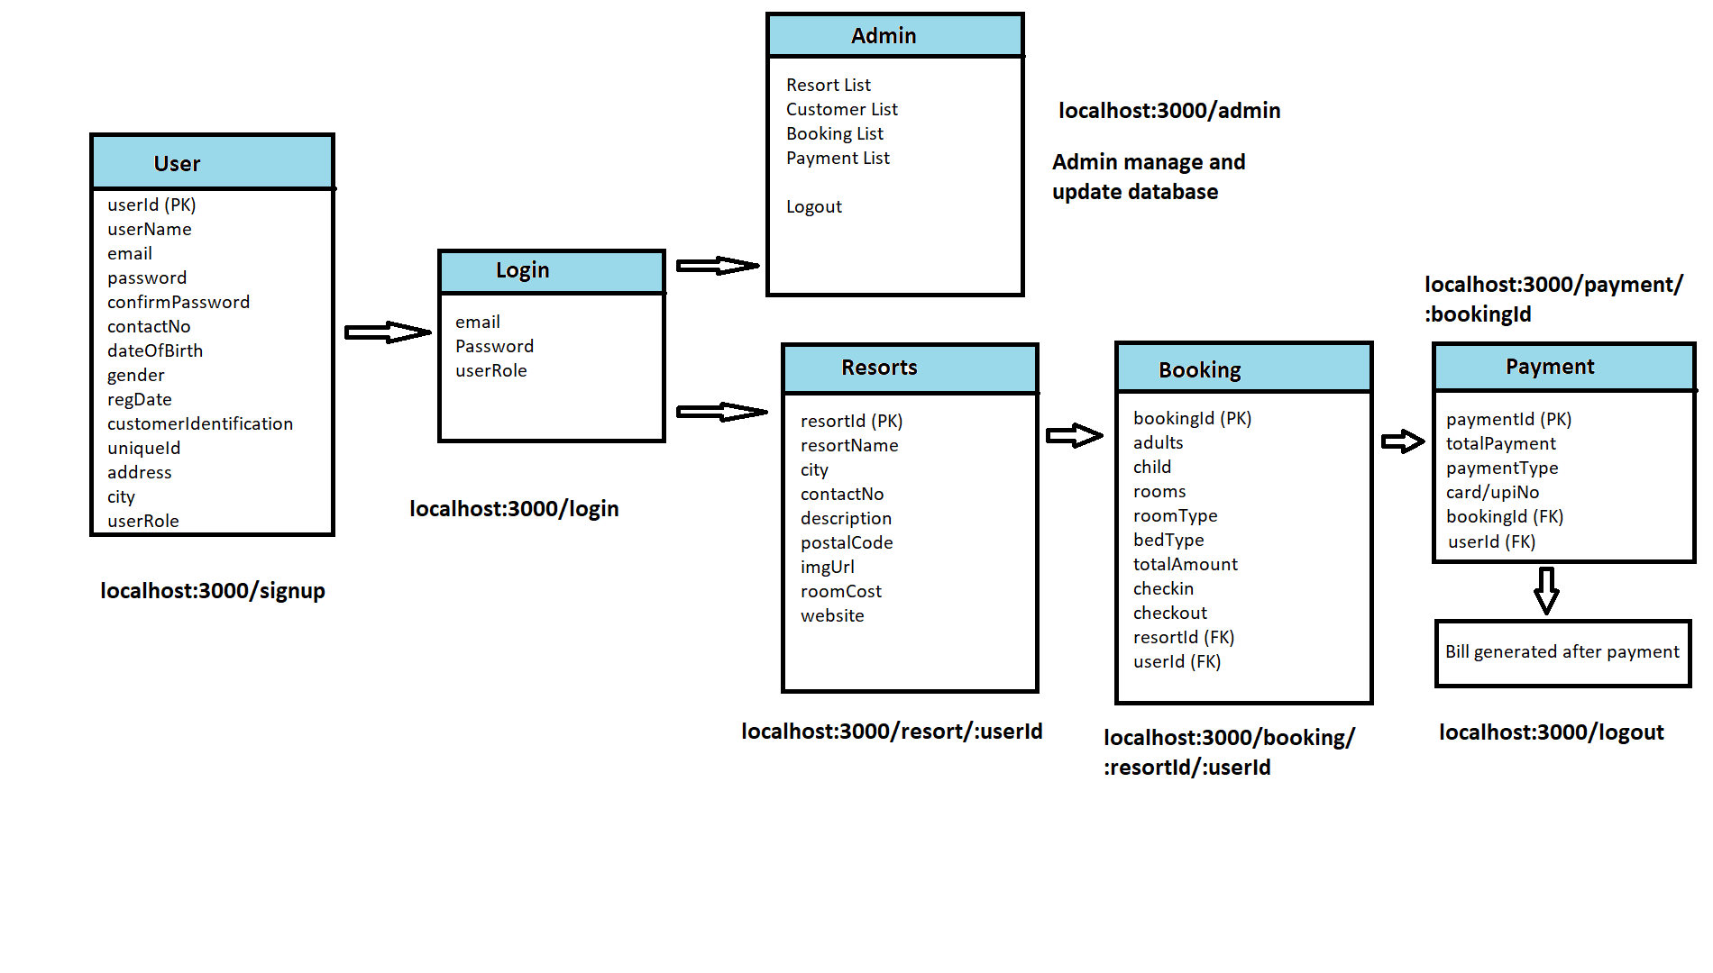
Page Navigation and Components Diagram

Slide 13
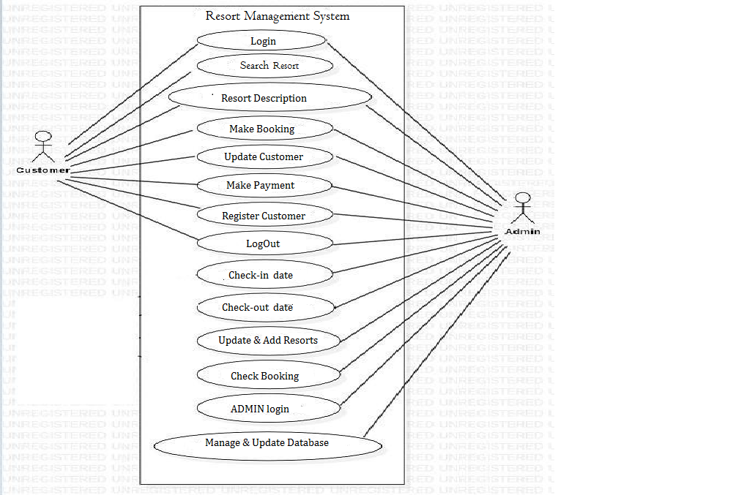
Data Flow Diagram

Slide 14
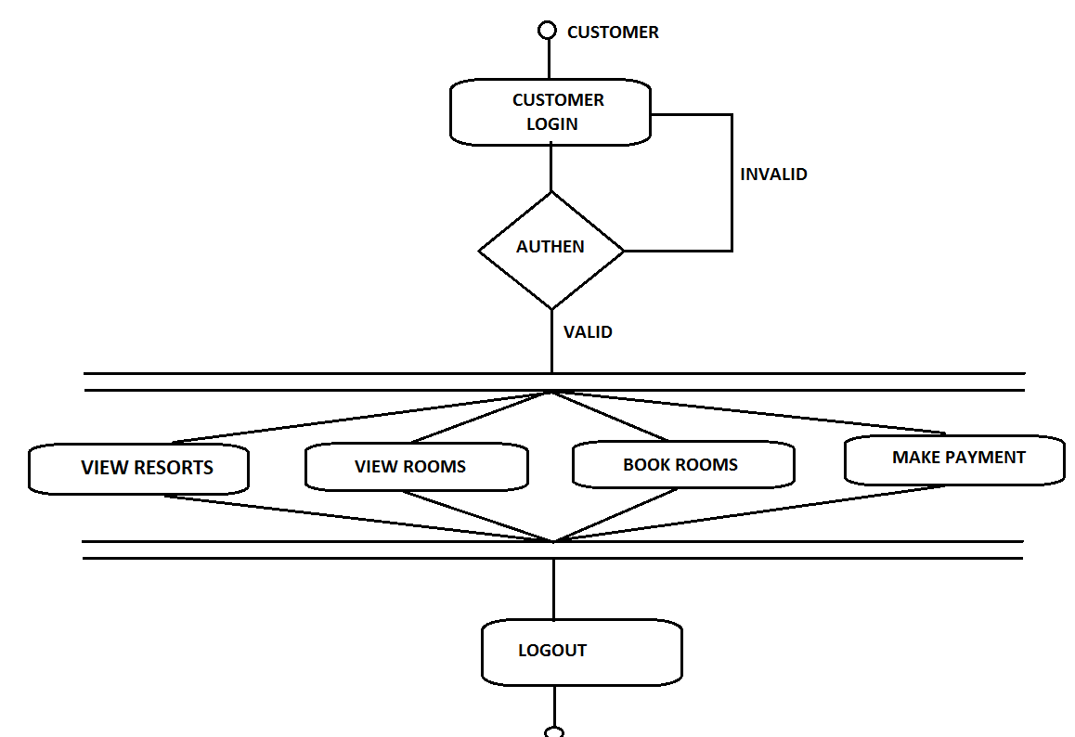
Customer Activity Flow Diagram

Slide 15
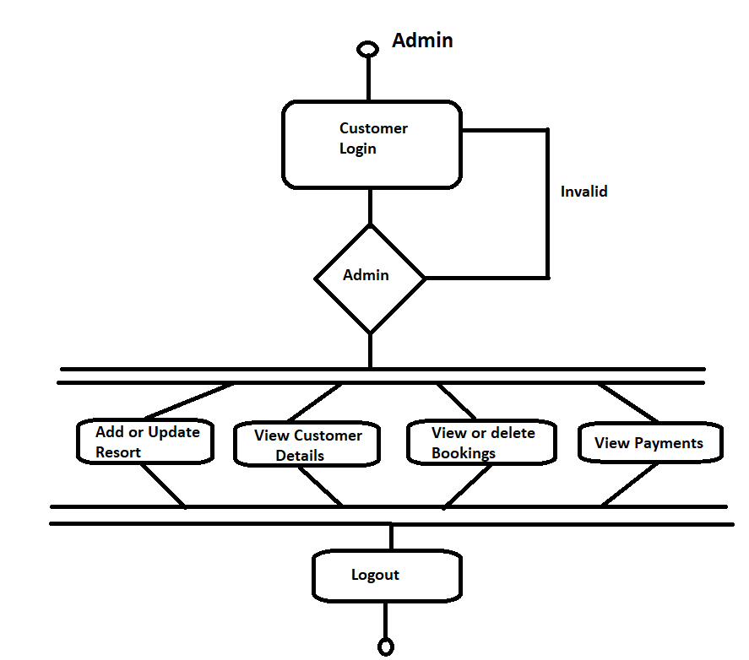
Admin Activity Flow Diagram

Slide 16
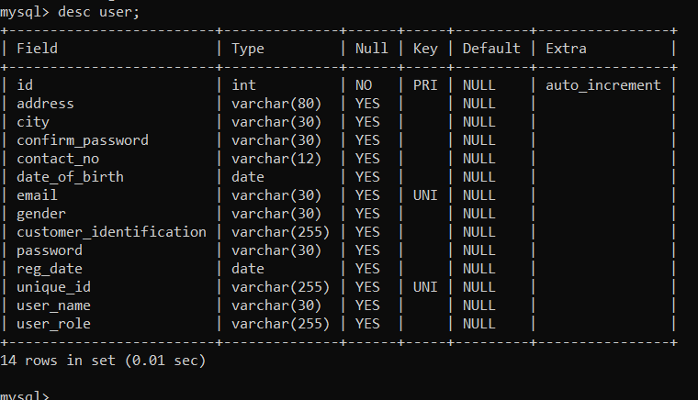
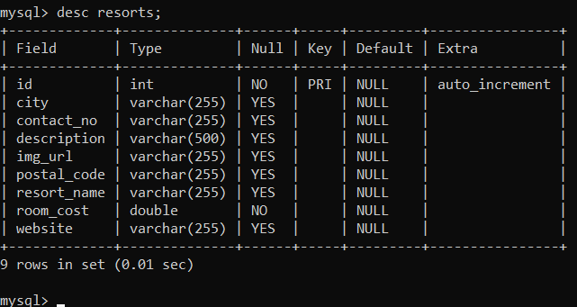
DATABASE TABLE STRUCTURE: (MYSQL)
USER TABLE
RESORTS TABLE

Slide 17
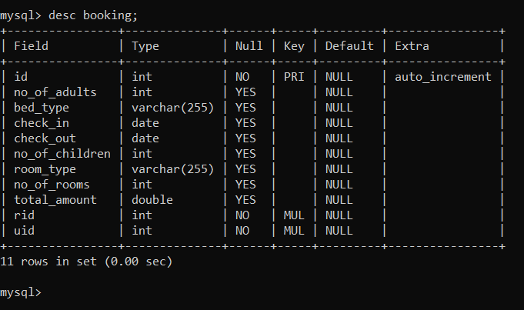
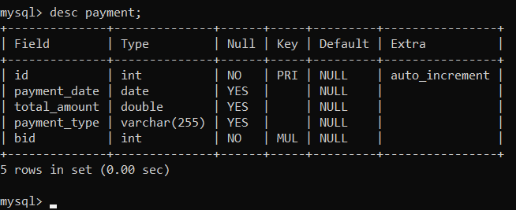
DATABASE TABLE STRUCTURE: (MYSQL)
BOOKINGS TABLE
PAYMENTS TABLE
BILLING GENERATED
LOGOUT
Customer successfully logout!!!!!!

Slide 18
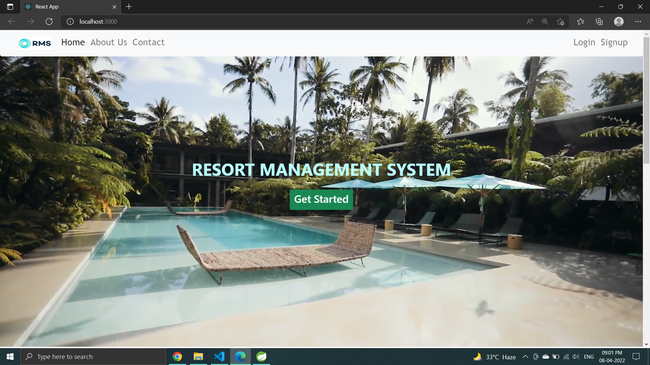
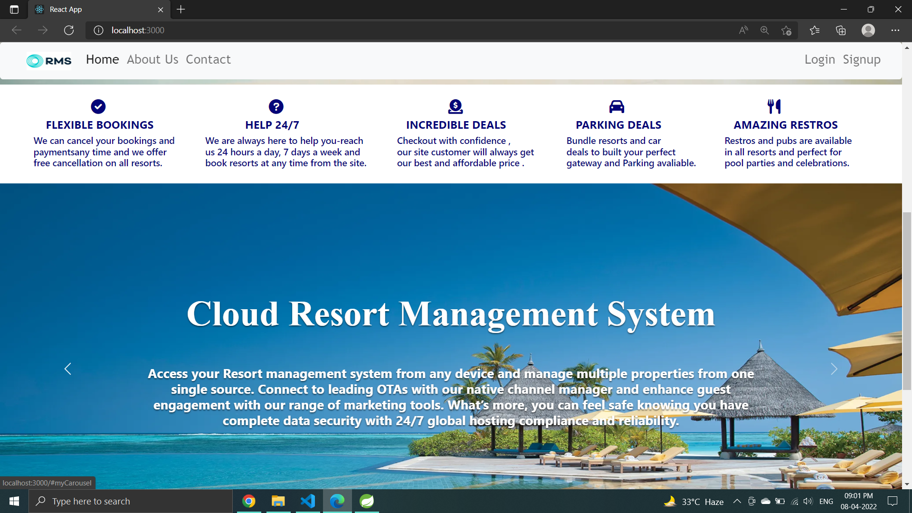
Screenshots
HOME/LANDING PAGE

Slide 19
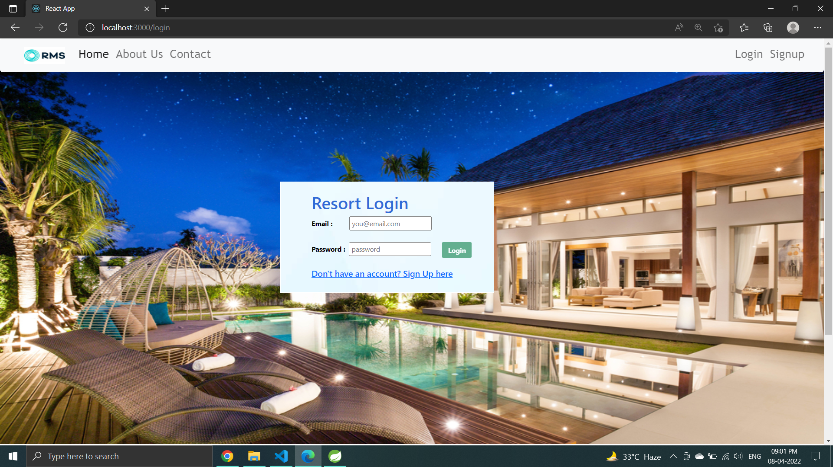
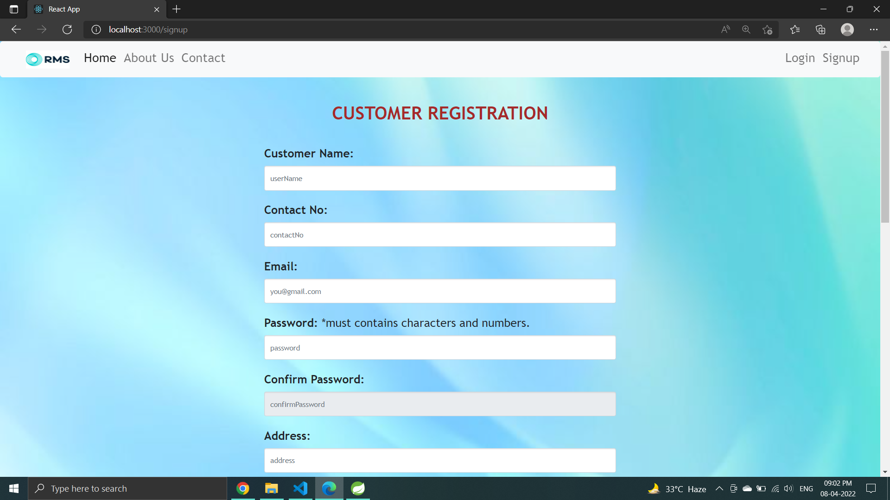
CUSTOMER LOGIN PAGE REGISTRATION PAGE

Slide 20
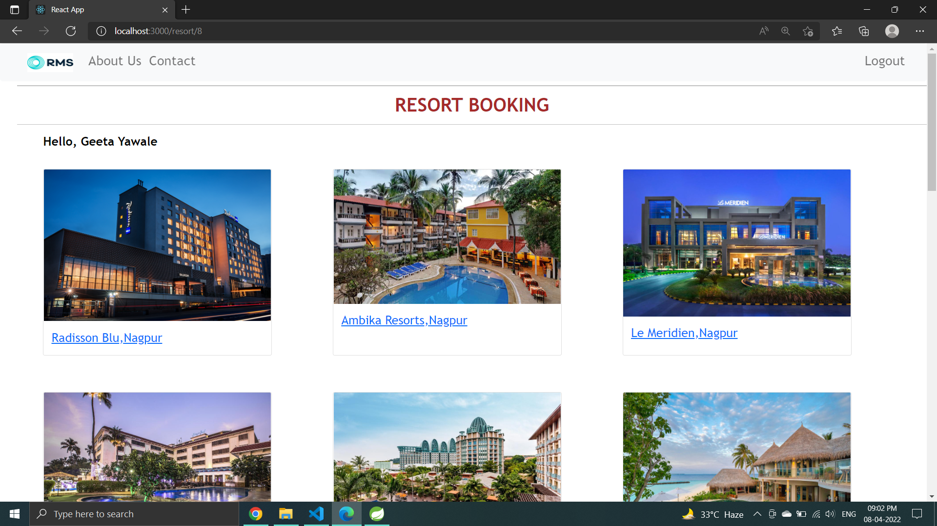
RESORTS DISPLAY PAGE

Slide 21
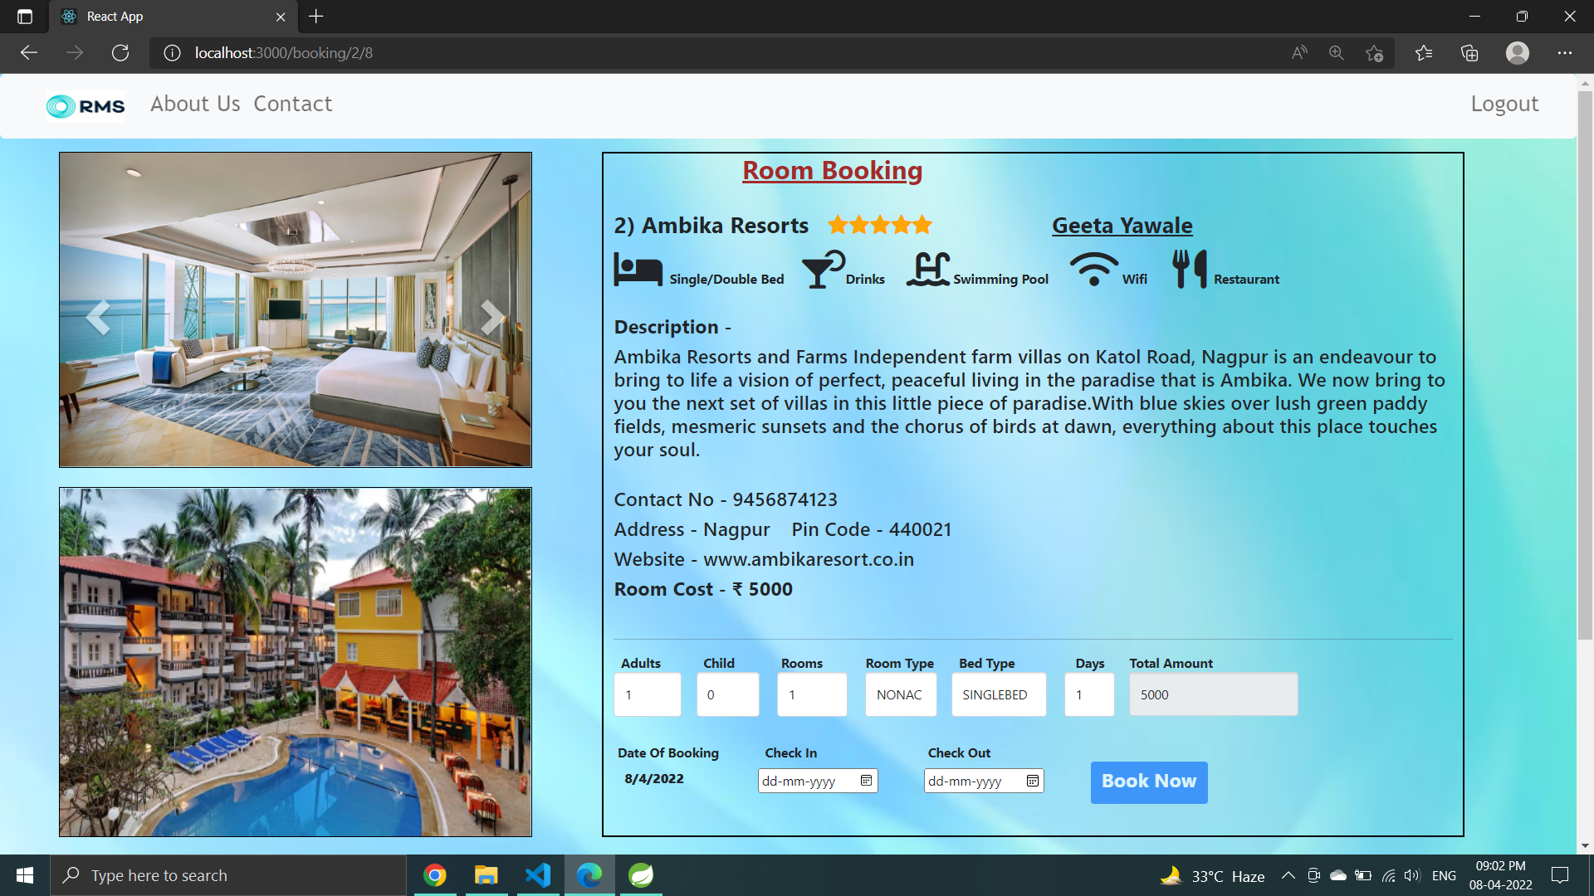
BOOKINGS PAGE

Slide 22
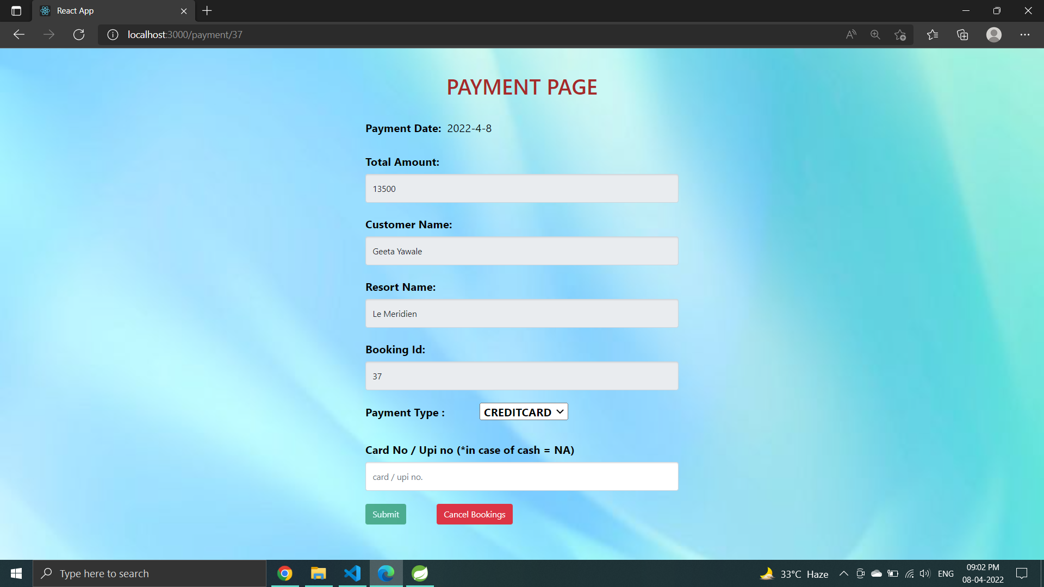
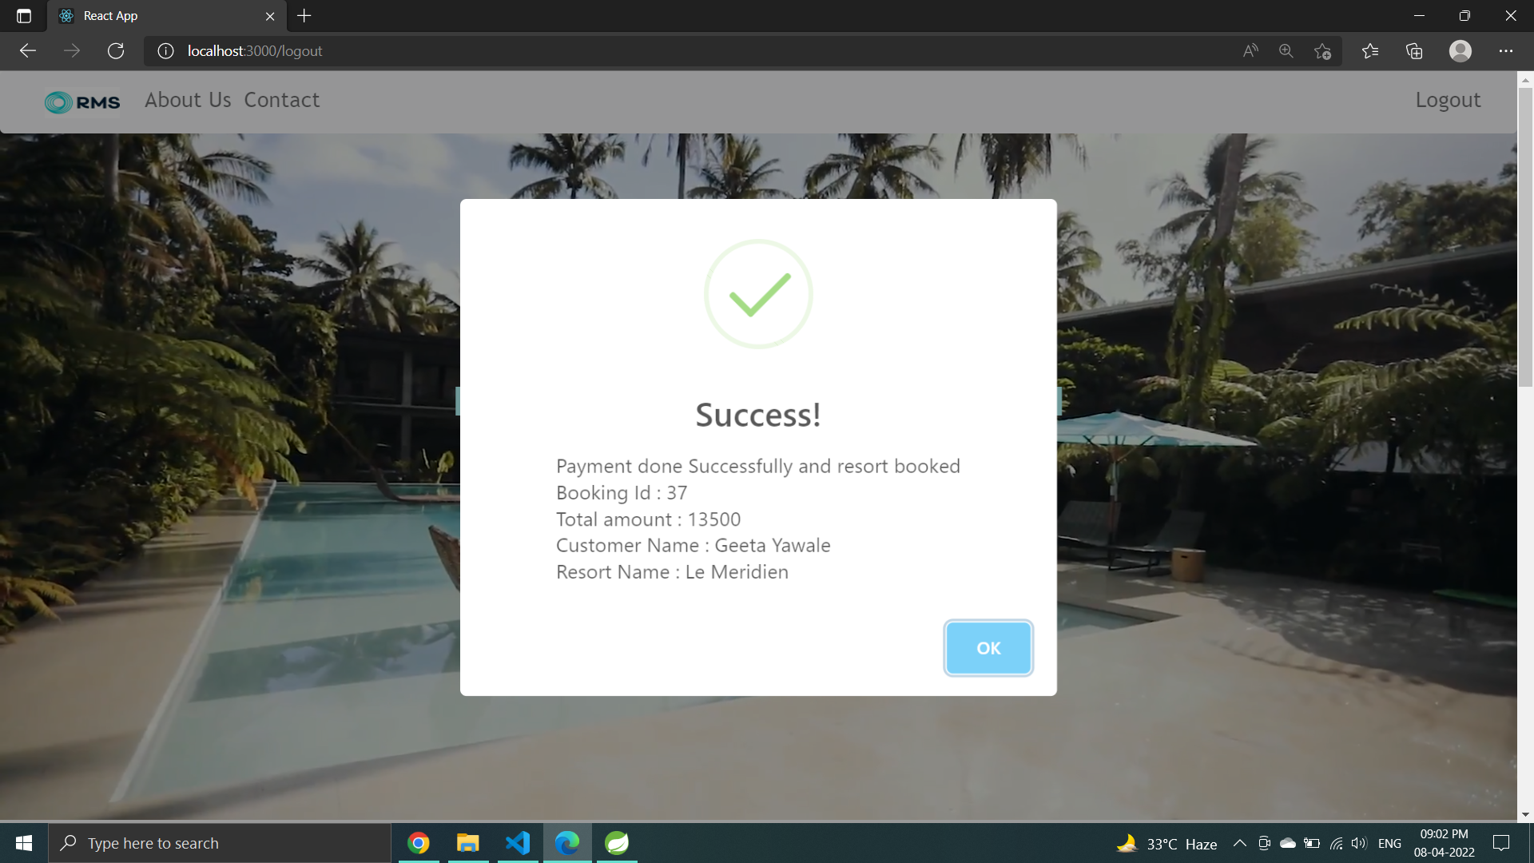
PAYMENT PAGE BILL/LOGOUT PAGE

Slide 23
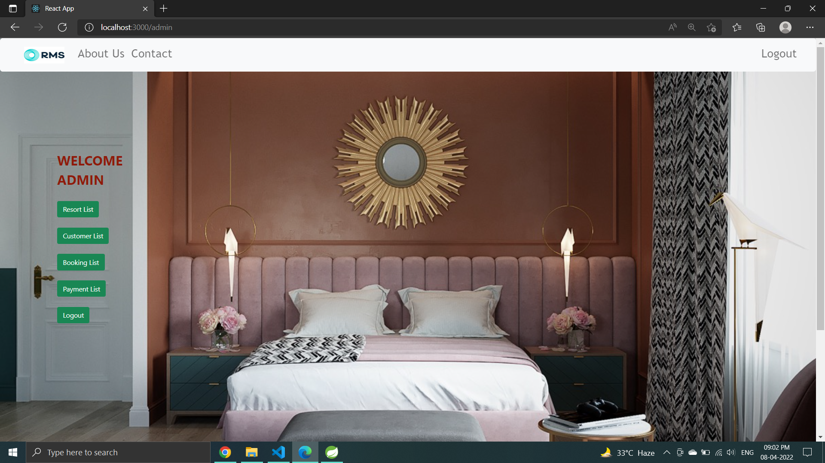
ADMIN PAGE

Slide 24
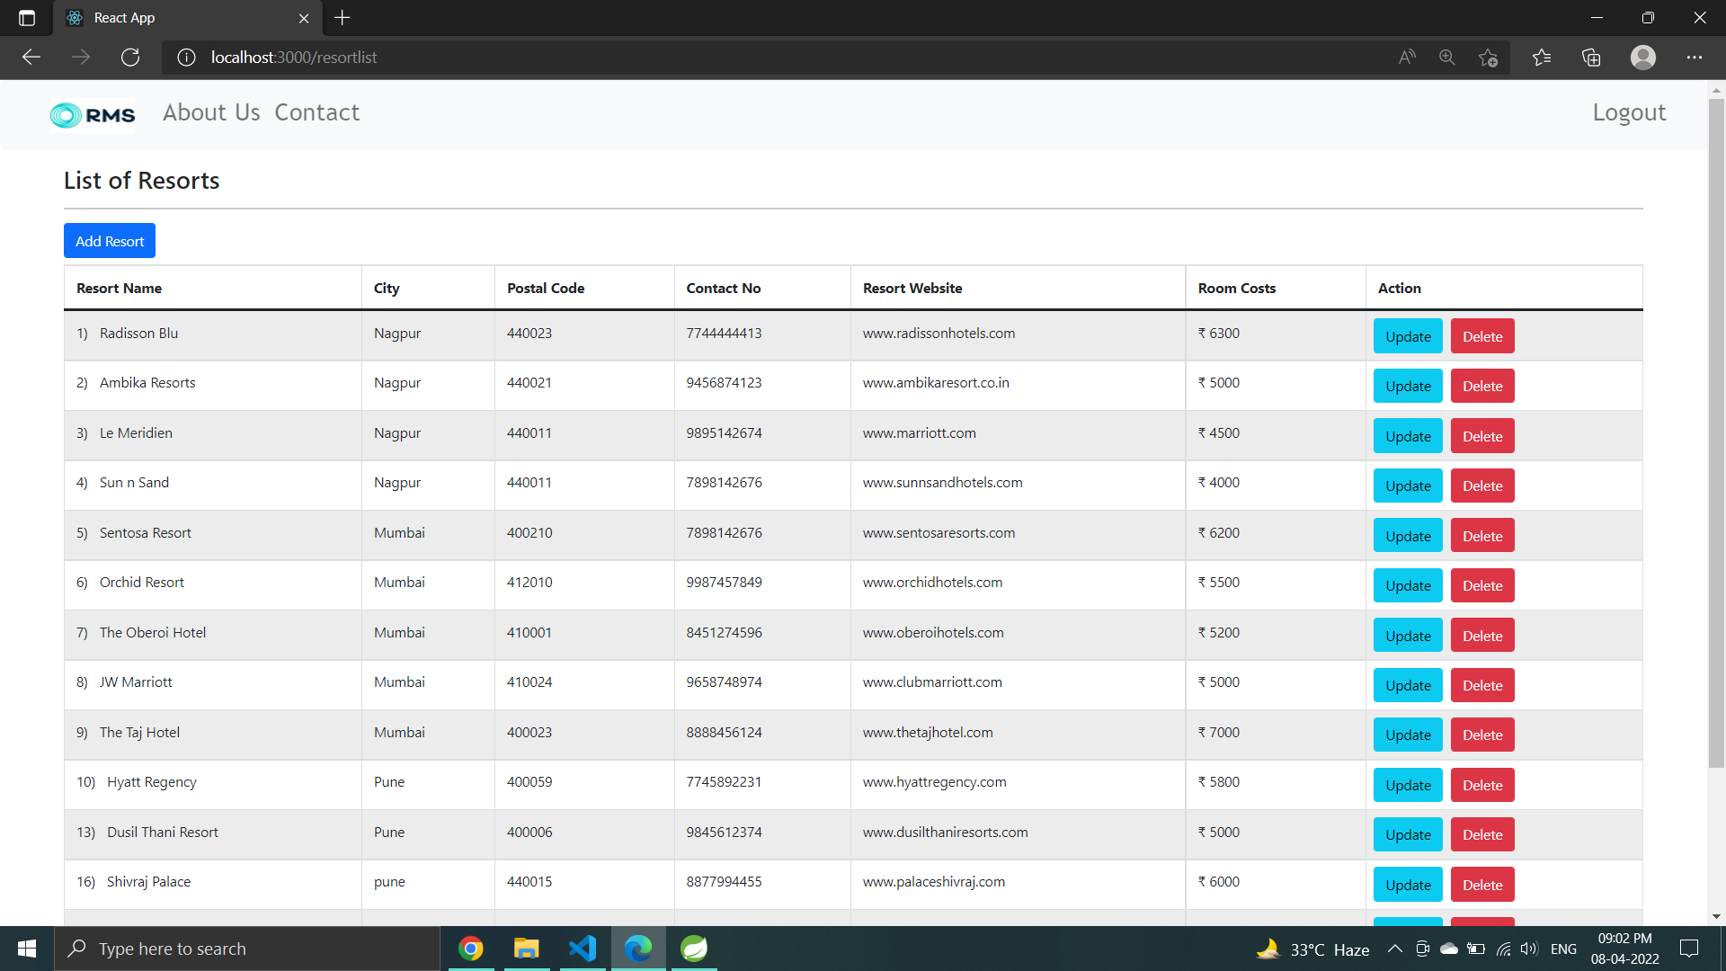
ADD , UPDATE , DELETE AND GET RESORTS

Slide 25
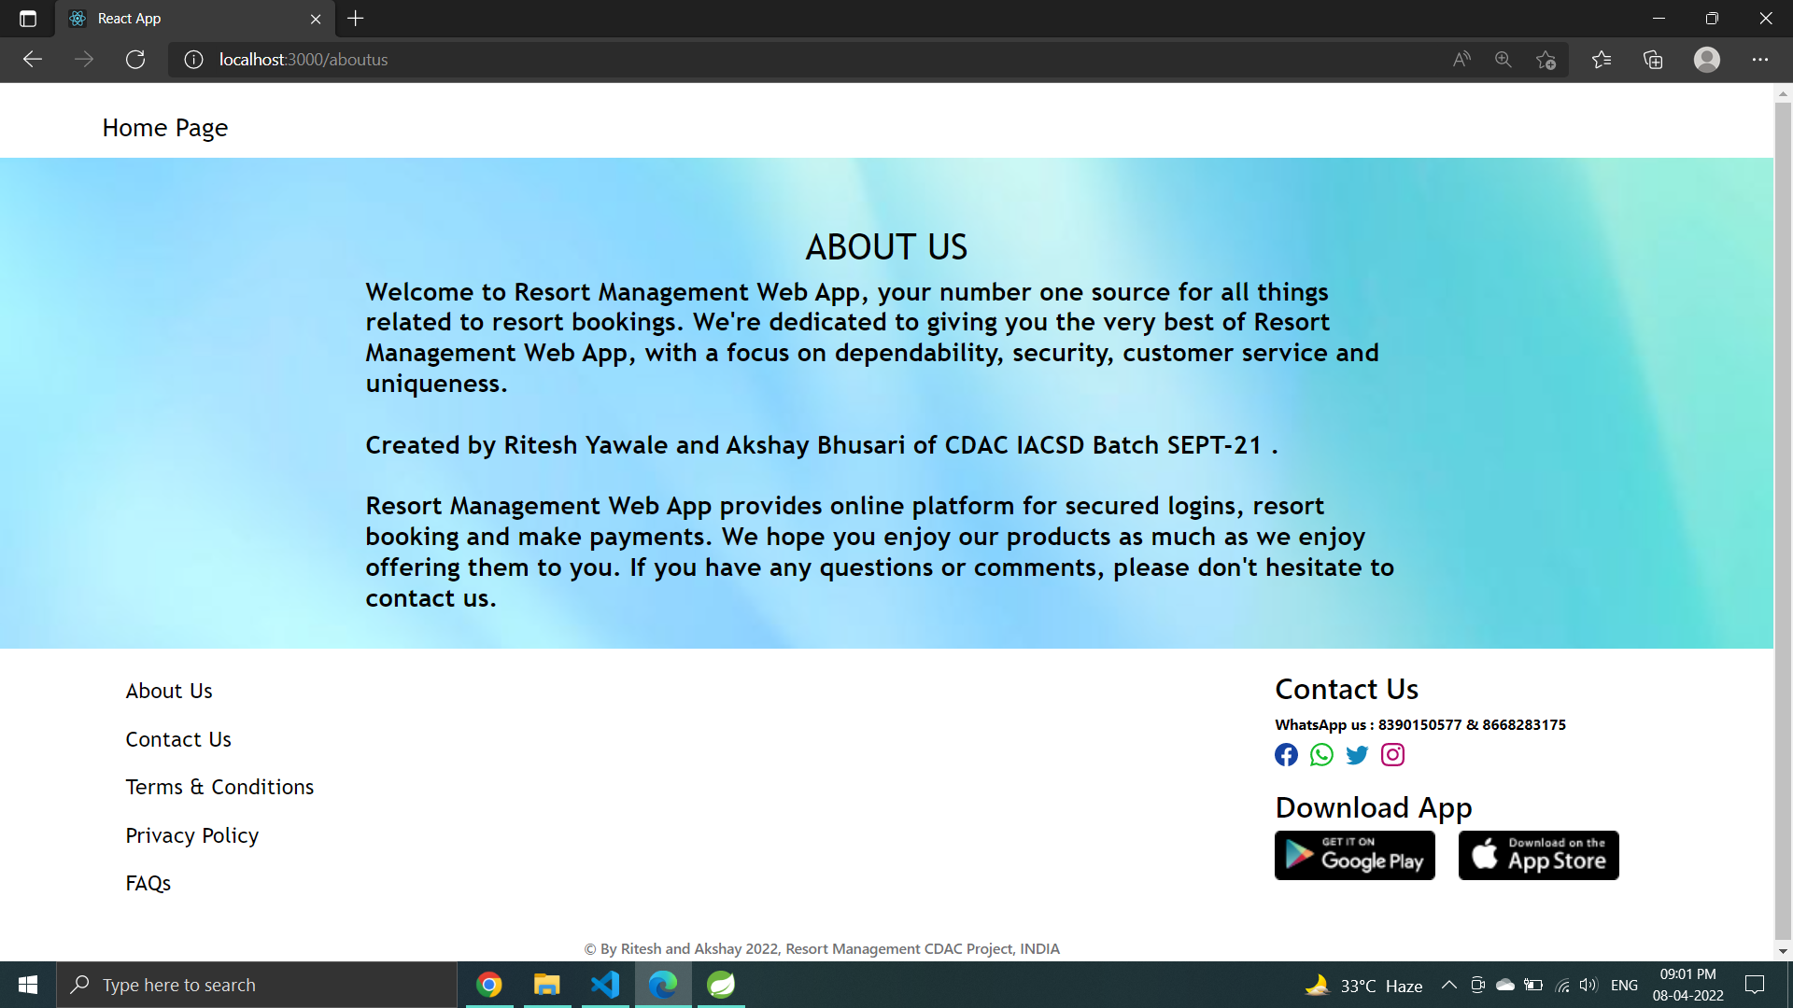
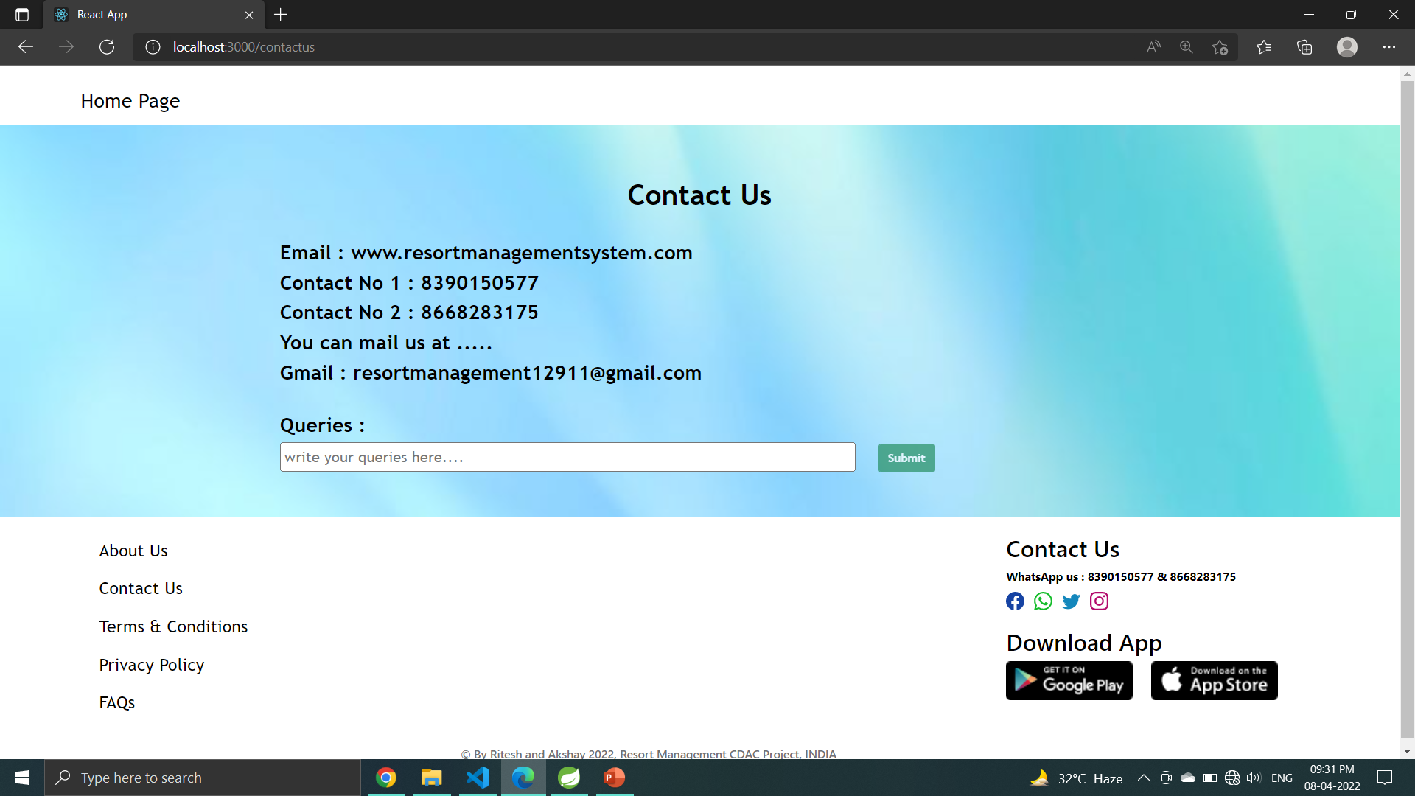
ABOUT US PAGE CONTACT US PAGE

Slide 26
Future Enhancement
This project can be enhanced further by adding payable additional courses, online feedback system, online payment facility for the members to reduce the extra work of the admin. The software is flexible enough to be modified and implemented as per future requirements. We have tried our Best to present this free and user–friendly website to Institutes.

Slide 27
Conclusion
In Resort management system, We have developed a secure , user-friendly Resort Management System. This system can take care of each member whether its admin or customer. This System will help them to properly manage their Resort and help in growth without creating and hassle. This system is completely secure since every user is provided with user id and Password so there is no chance of any unauthorized access, online Payment, Booking and cancellation make it easier to use . So, using this system will help in reducing the time and provide more facility for customer to like Resort and visit again and again.

Slide 28
References
[1] Core Java And Advanced Java With Crud Operation Lectures Conducted by Madhura Mam.
[2] Java By Budo Timothy “Understanding Object- Oriented Programming with JAVA” . Pearson,1999
[3] Java By Balgurusamy E “ Programming with JAVA, A Primer” Tata Mcgraw Hill,2006.
[4] Web Programming Technologies with reactjs , html, bootstrap by Kishori mam.
[5] Database technology with Crud Operations by Kishori mam.

Slide 29
Thank You!!!

